Slide 1
Console-based CRUD App
https://github.com/paulchinnam/Java_HRIS_System
Paul Chinnam

Slide 2
Discussion Topics
Project workflow, database & package structure
Implemented classes
Live Demo
Questions

Slide 3
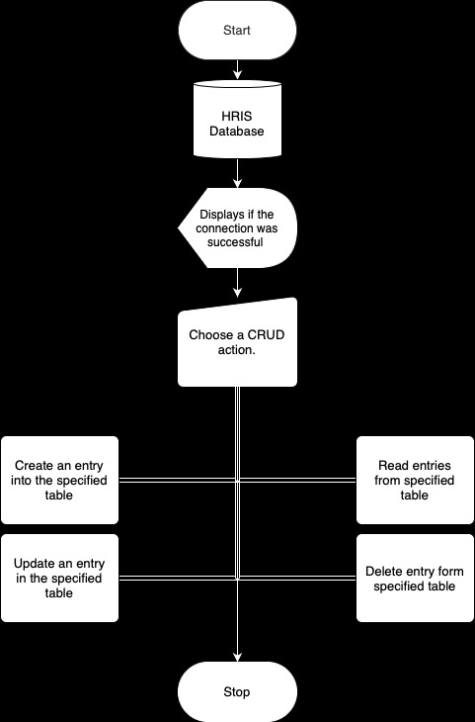
Project Workflow

Slide 4
Database Schema
HRIS
Benefits table
Employee table
Payroll table

Slide 5
Benefits Table
ID | Health | Dental | Vision
1 | None | None | None
2 | Basic | None | None
3 | Basic | Basic | None
4 | Basic | Basic | Basic
5 | None | Basic | Basic
6 | Basic | None | Basic
7 | None | None | Basic

Slide 6
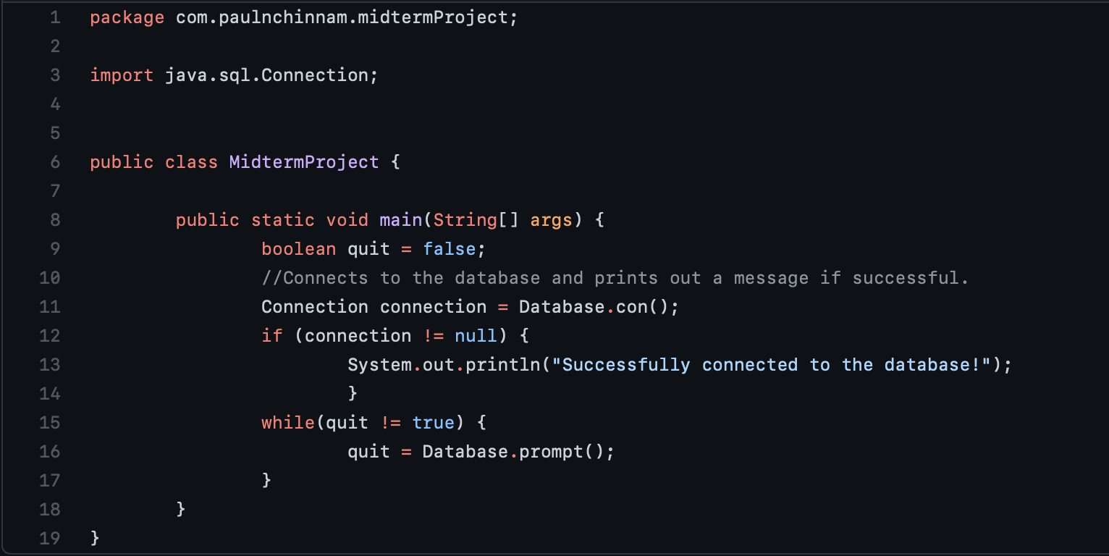
Package Structure
Classes
Read
Update
Delete
Create
Database
MidtermProject (main class)

Slide 7
Database Integration
Methods
Con()
Establishes connection to database
Maven connection class
Prompt()
Prints CRUD options to console
User input determines CRUD action
Exit feature

Slide 8
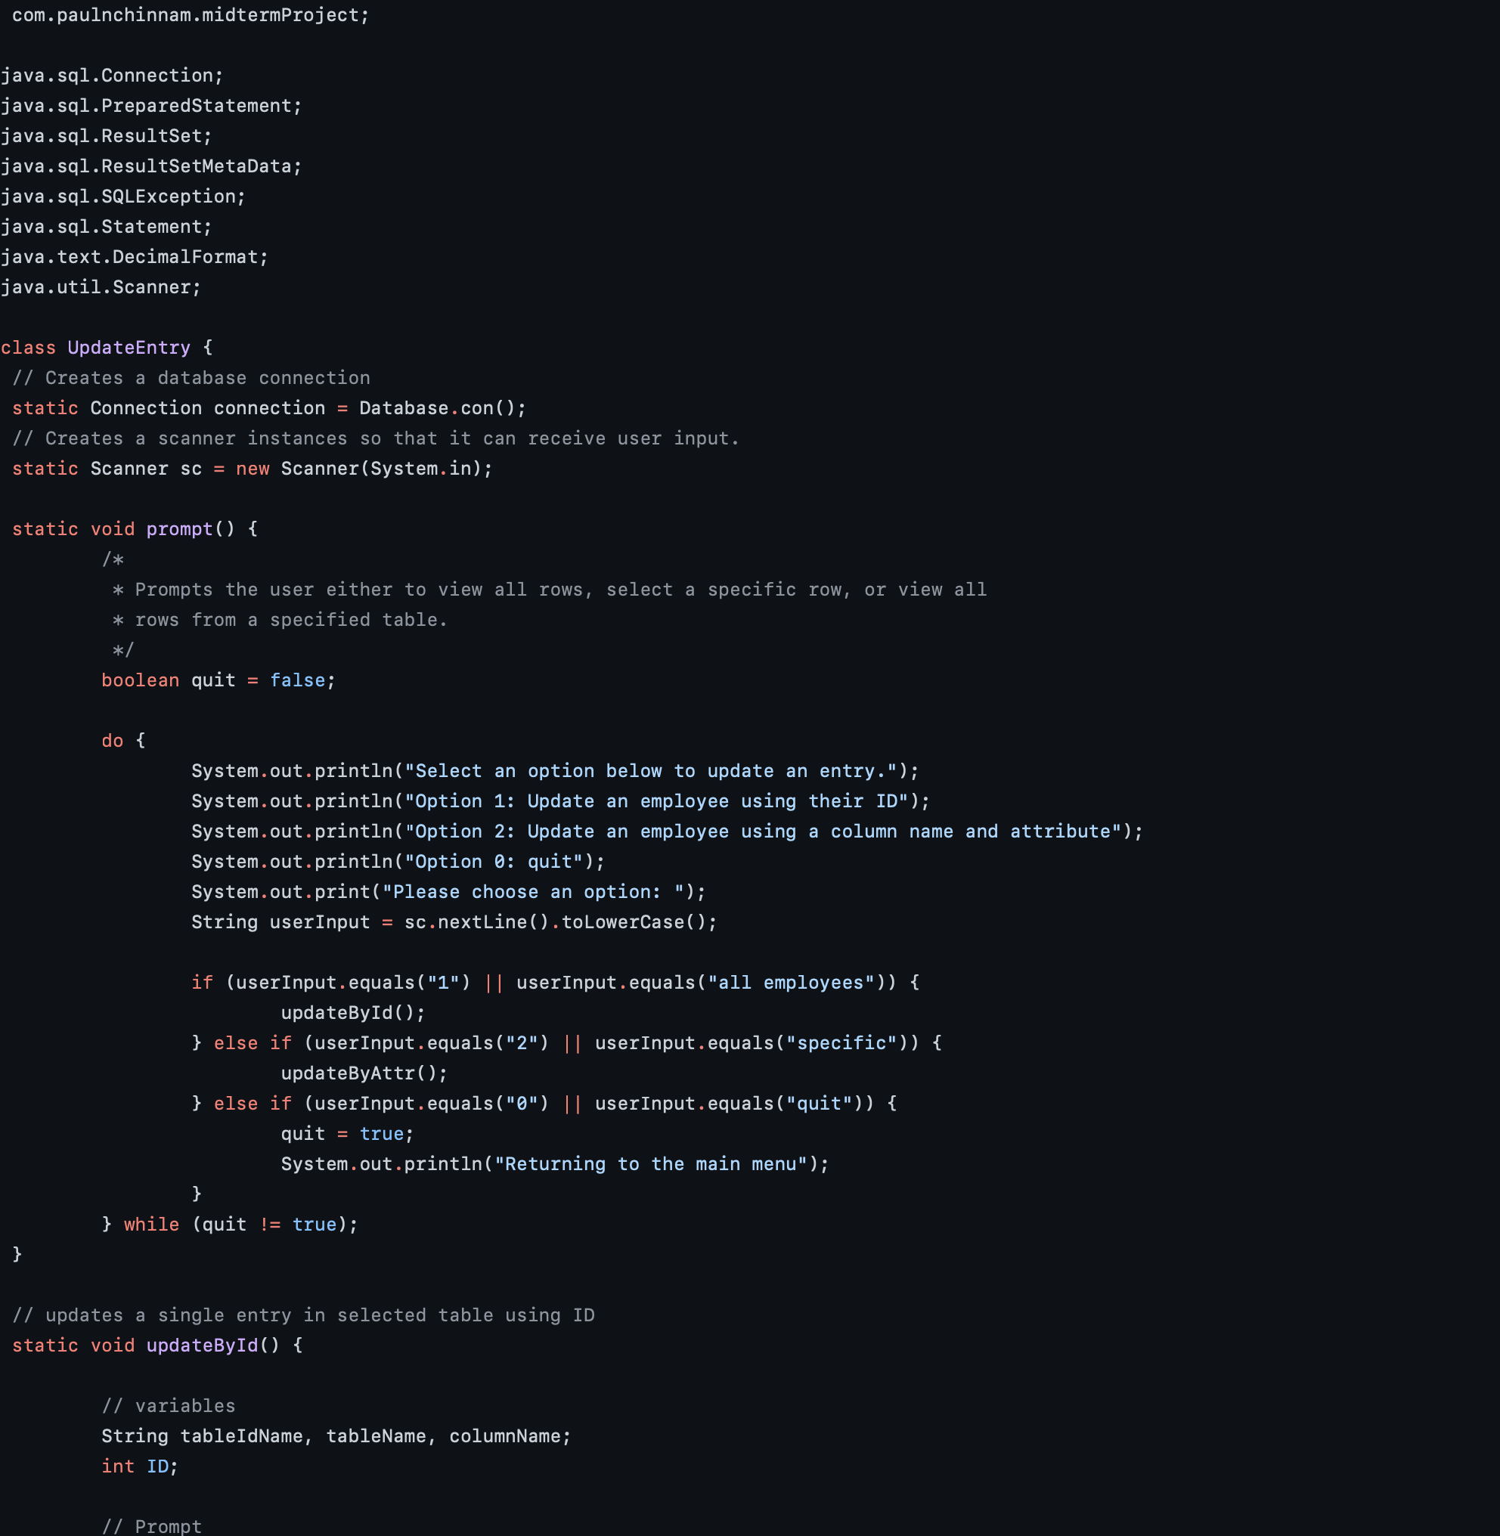
Update Entry
Update data by ID
Update data by attribute

Slide 9
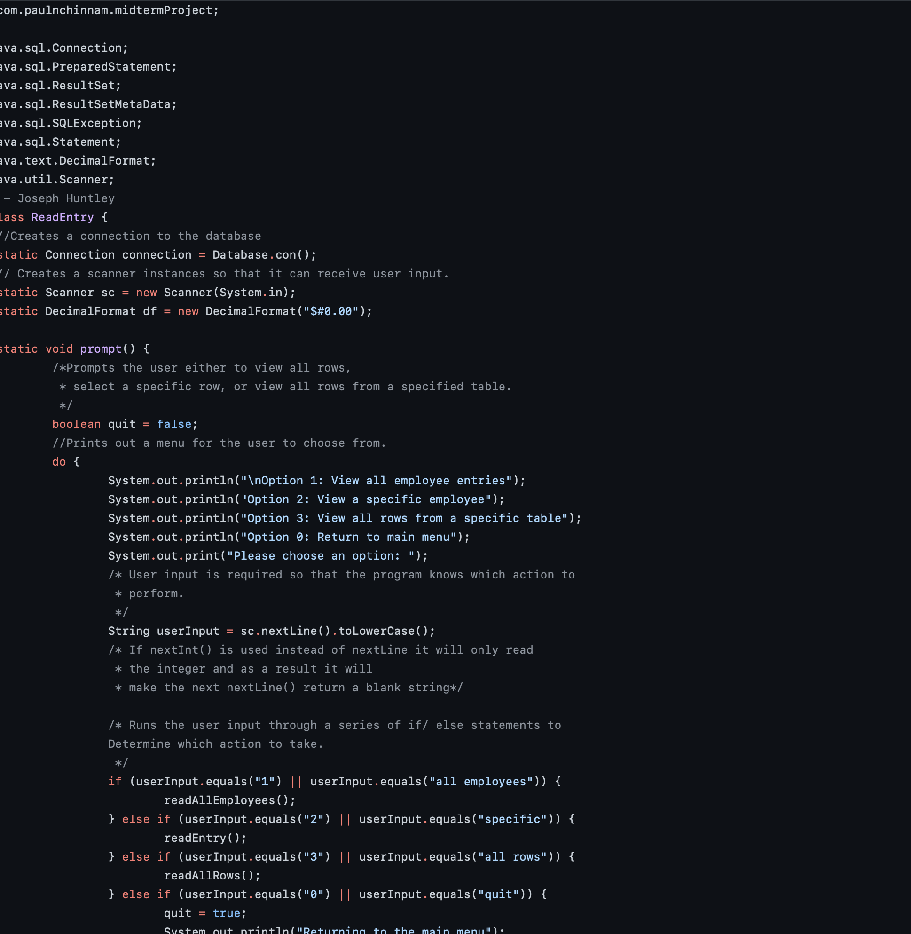
Read Entry
View all employees
View a specific employee
View all data from specified table

Slide 10
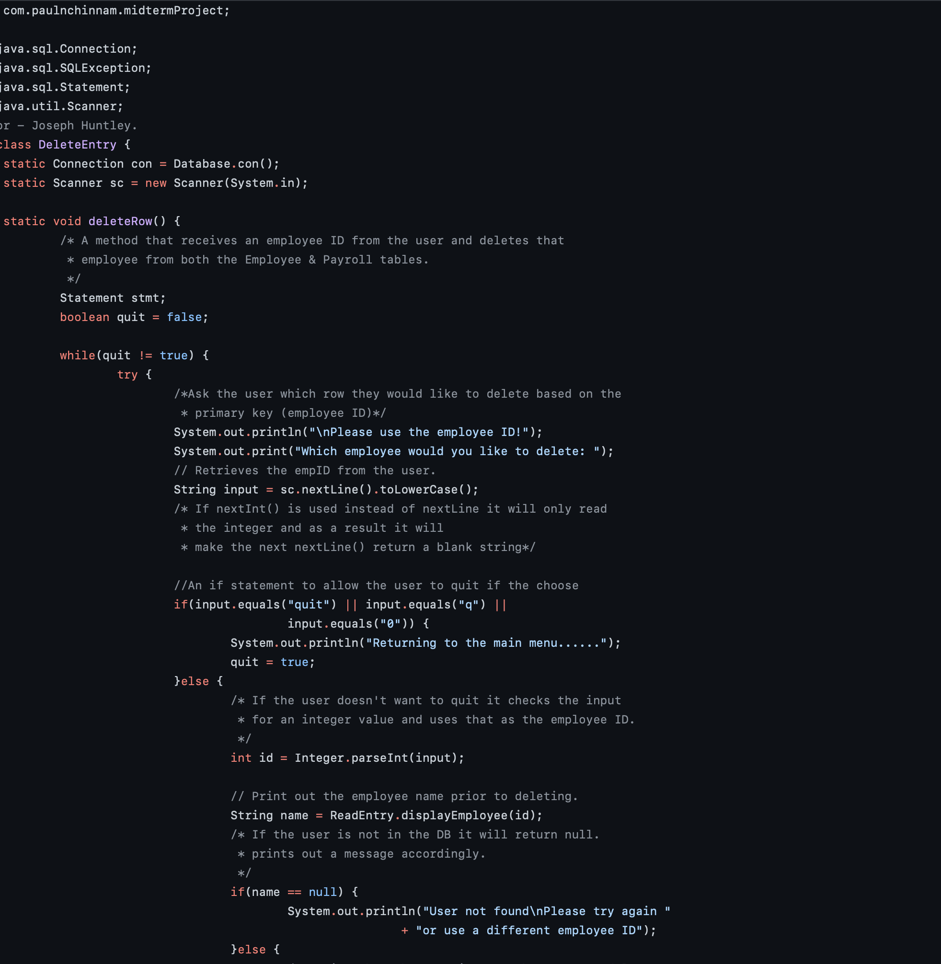
Delete Entry
Deletes employee information based on ID
Reinforces referential integrity
Returns to main menu

Slide 11
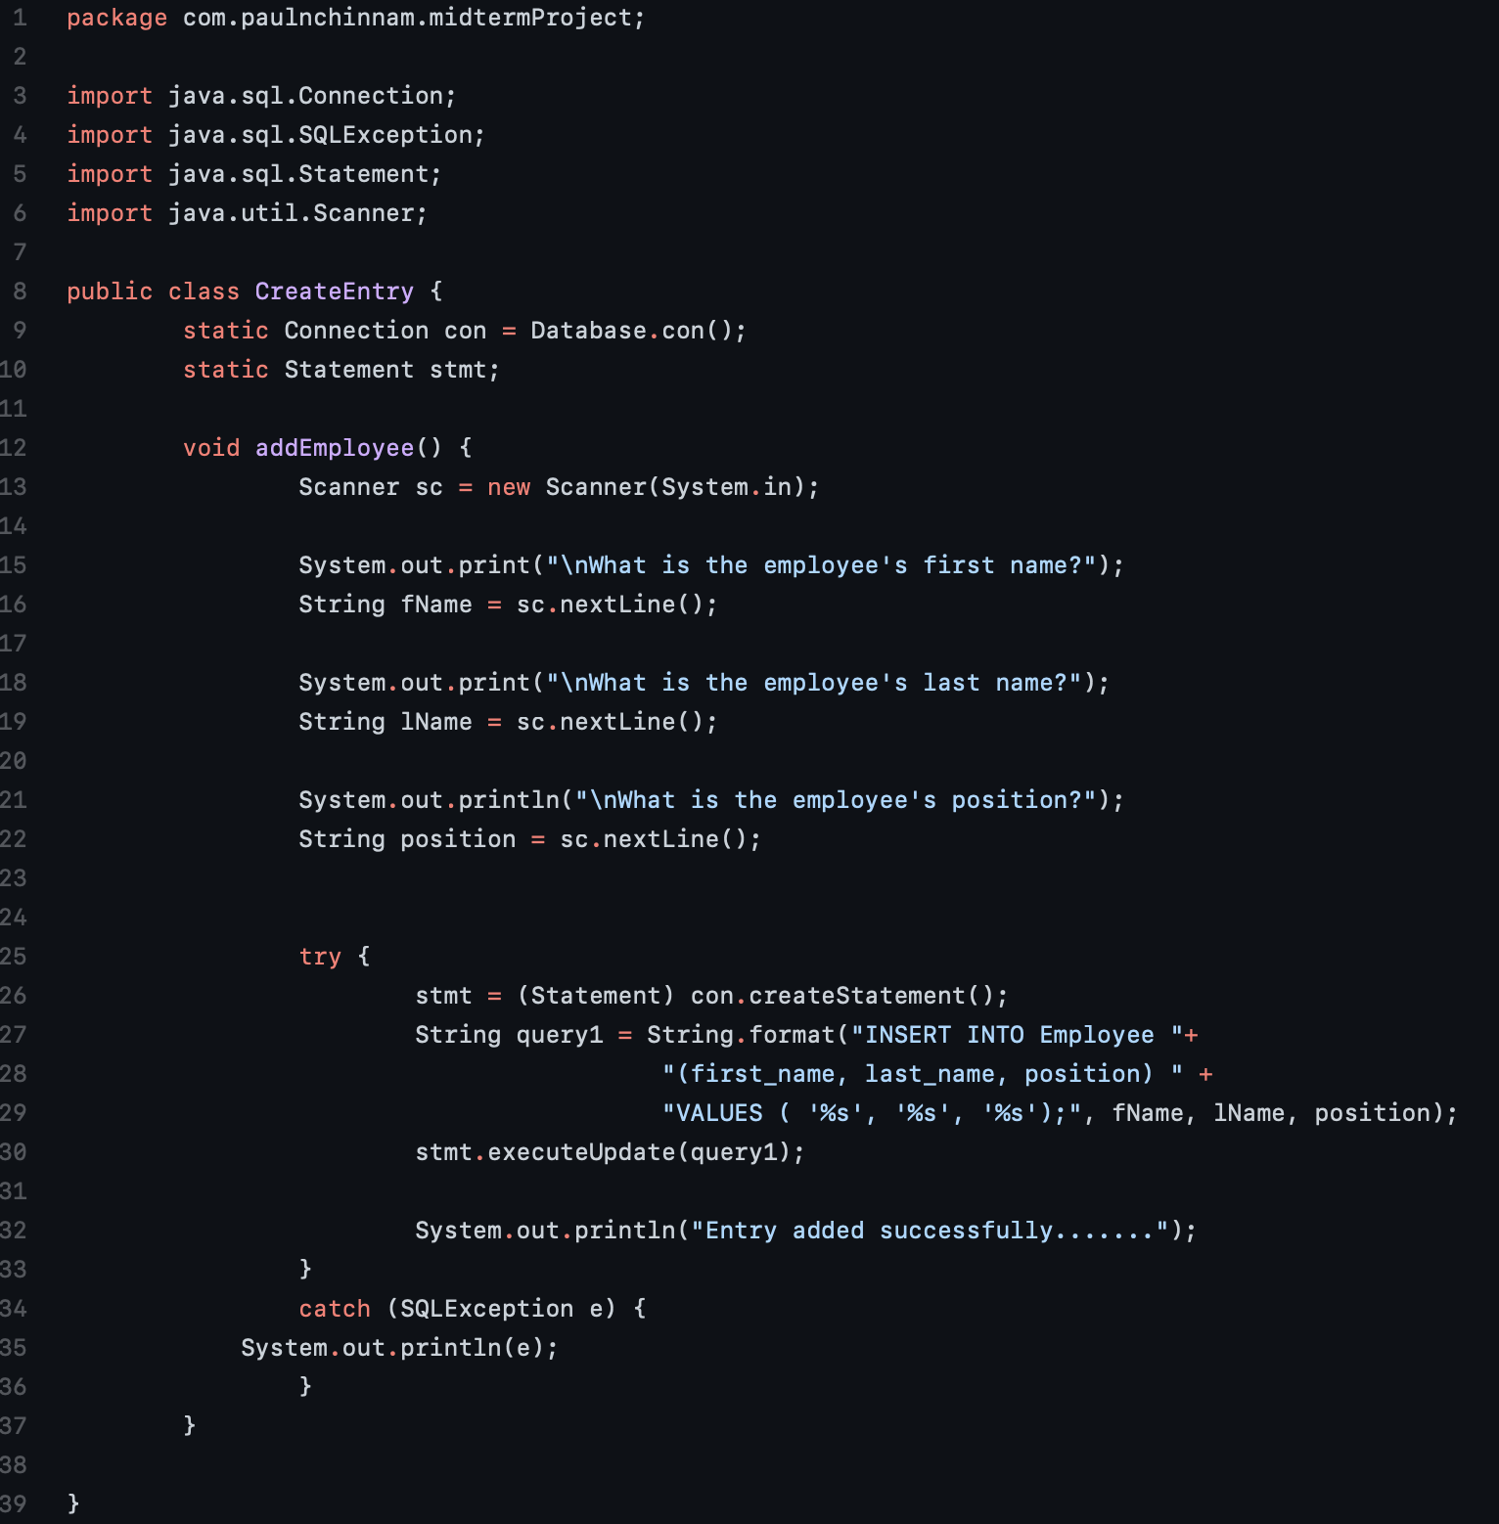
Create Entry
Collects values from user input for hris records
addEmployee() prompts user
Try/catch executes SQL query

Slide 12
Live Demo

Slide 13
Questions

